Slide 1
SCRABBLE ASSISTANT
(Team : lena)
Team Members:
Shaurya Rajat Dewan (2019101017, CSE)
Chirag Shameek Sahu (2019102006, ECE)
Harshwardhan Prasad (2019102021, ECE)
Shivanshu Jain (2019101001, CSE)
Mentor TA: Fiza Husain
Repository URL: https://github.com/Digital-Image-Processing-IIITH/dip-project-lena

Slide 2
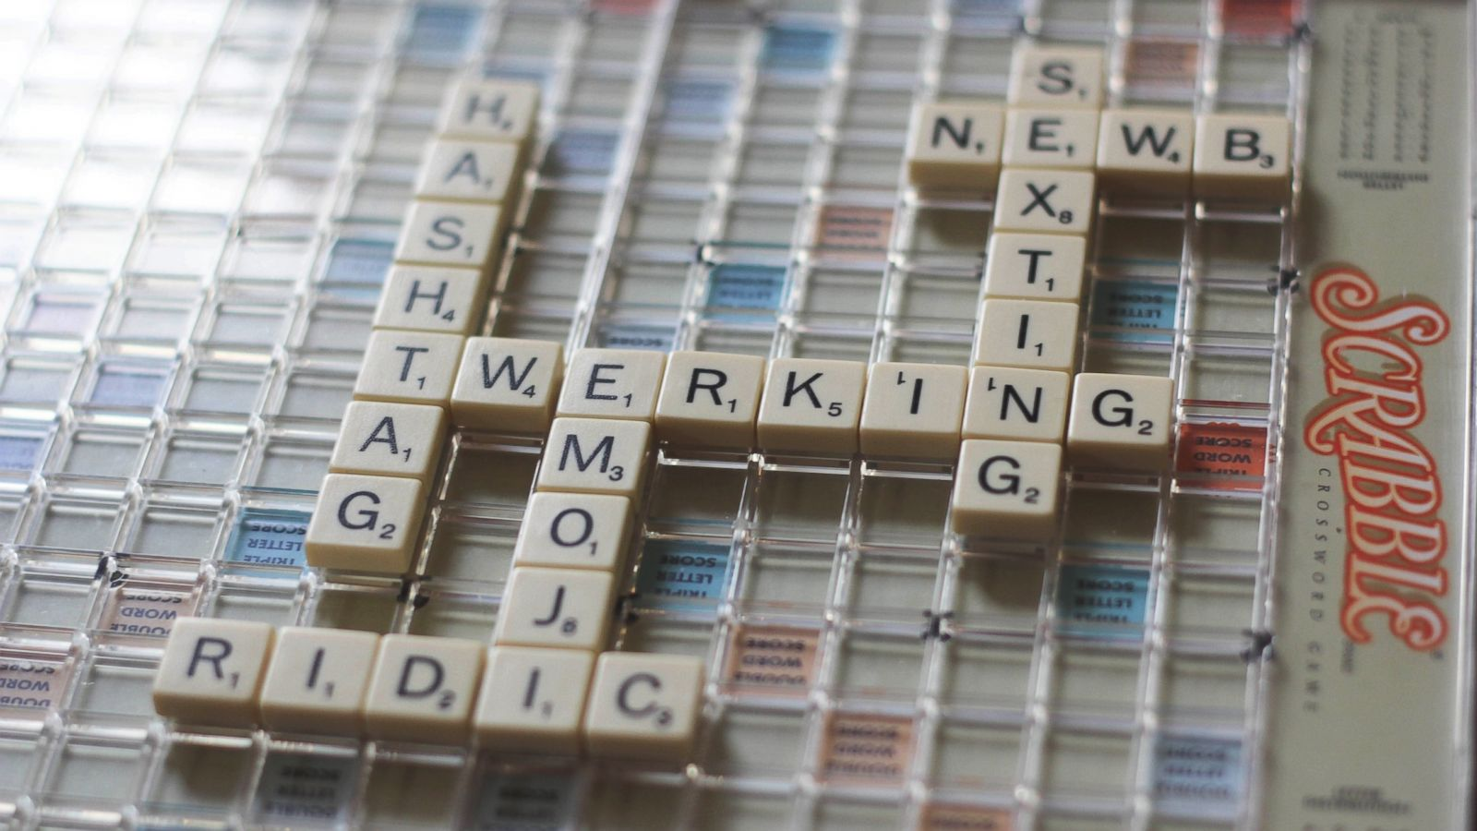
What is Scrabble?
An Introduction

Slide 3
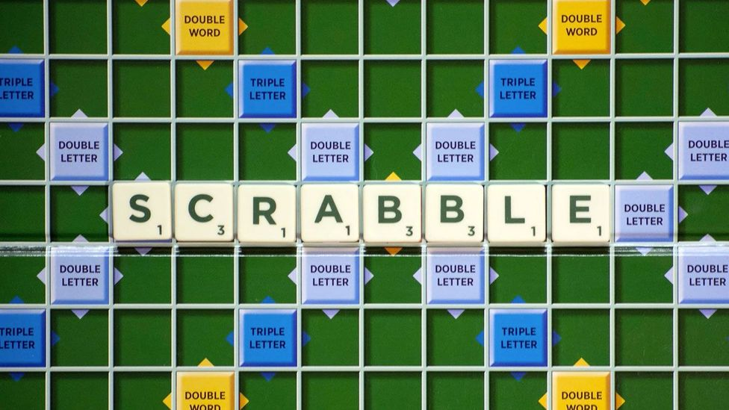
A two to four player board and tile game
Players take turns forming words using a set of seven letter tiles and placing them onto a grid.
Points are awarded based on the sum of values of individual letters, along with letter and word multipliers positioned regularly throughout the board.

Slide 4
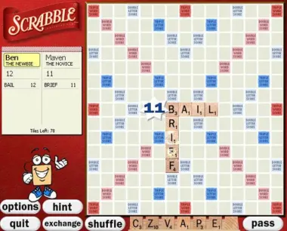
Goal
Digitizing the Scrabble board with the help of an image

Slide 5
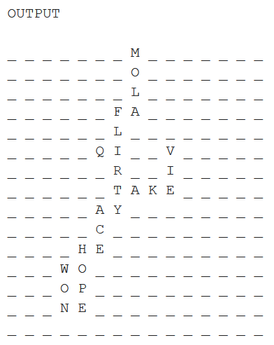
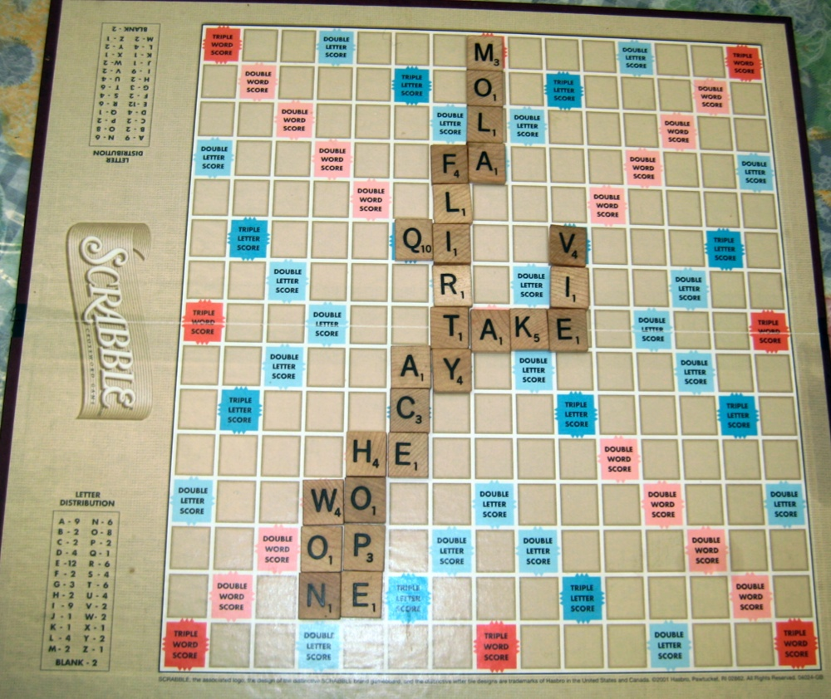
Result
With image processing techniques convert the image of the Scrabble board to a 15 X 15 text matrix

Slide 6
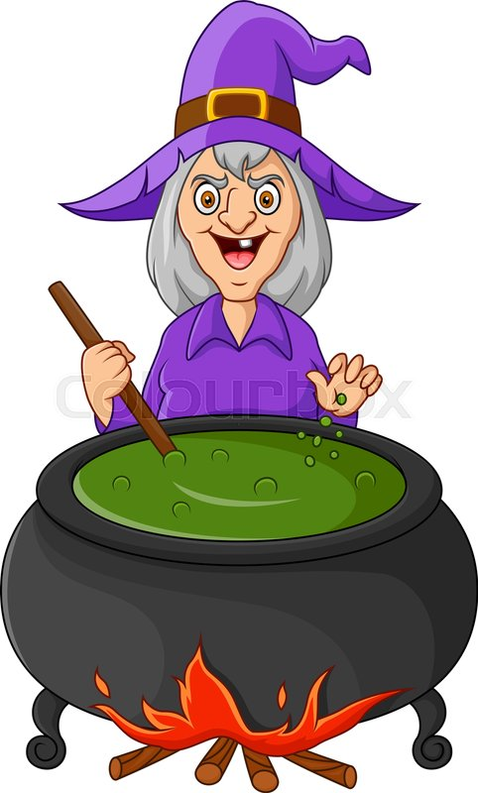

How To Do It?
The Procedure

Slide 7
Image Input
Collected author’s original dataset
The Scrabble Board image is given as input

Slide 8
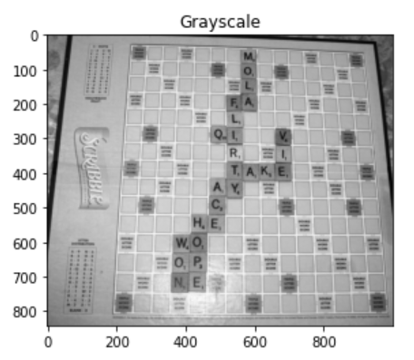
Preprocessing
Convert image to grayscale
Apply adaptive histogram equalization
Tile size estimation
Image size normalization

Slide 9
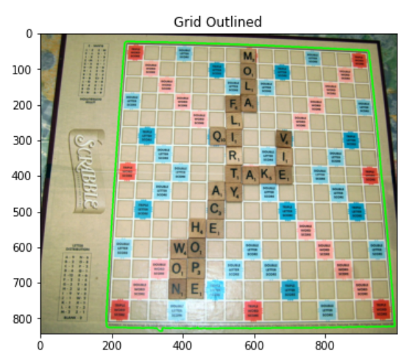
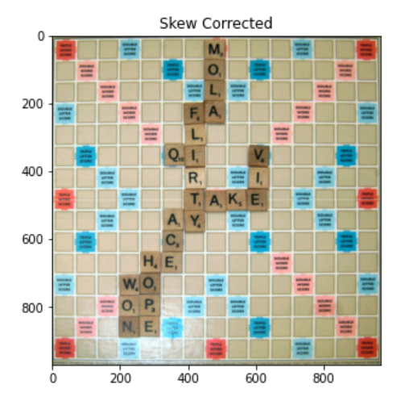
Grid Detection and Fitting
Grid detection by finding largest closed/dilated contour in edge map
Skew correction to crop out background and rotate image so that grid occupies entire image in correct orientation

Slide 10
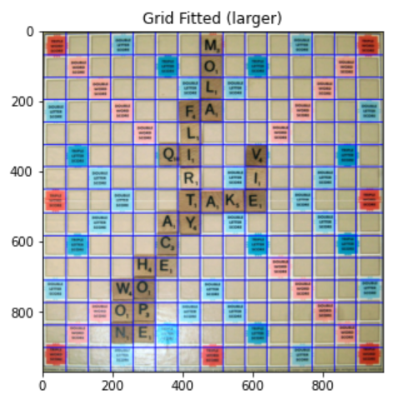
Grid fitting to divide corrected image into 15x15 grid

Slide 11
Character Detection and Recognition
Individual cells are identified and morphological operations are performed
Characters are detected by connected component algorithm
Pytesseract OCR is used to recognize the characters

Slide 12
Board Representation
A matrix output of the Scrabble board
Average accuracy: 85%
This output is stored in a text file

Slide 13
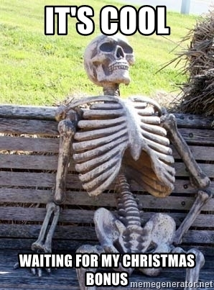
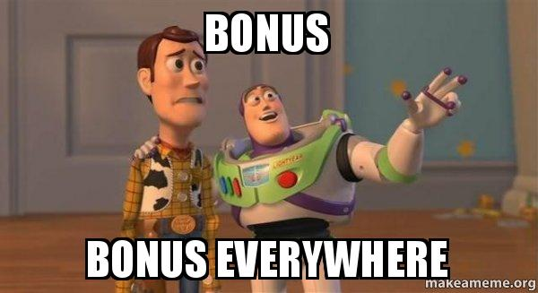
Bonus Segments
Let’s take to another level!

Slide 14
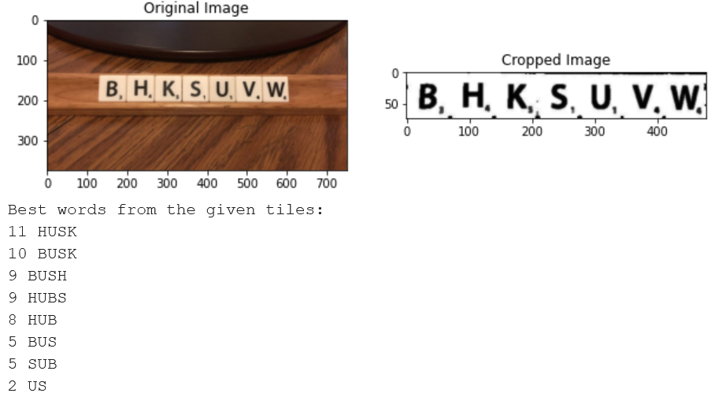
Oracle
Detect letters from tiles
Determine valid words that can be formed by different combinations and calculate the score to return the best word

Slide 15
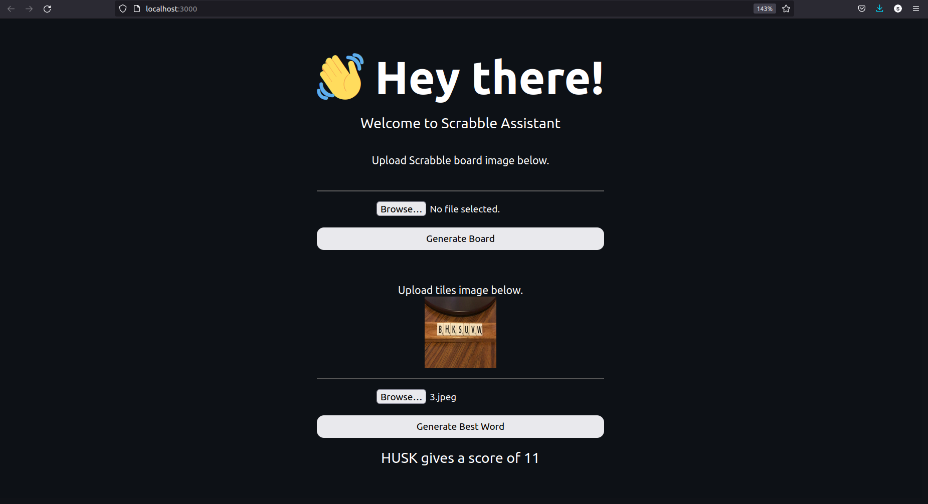
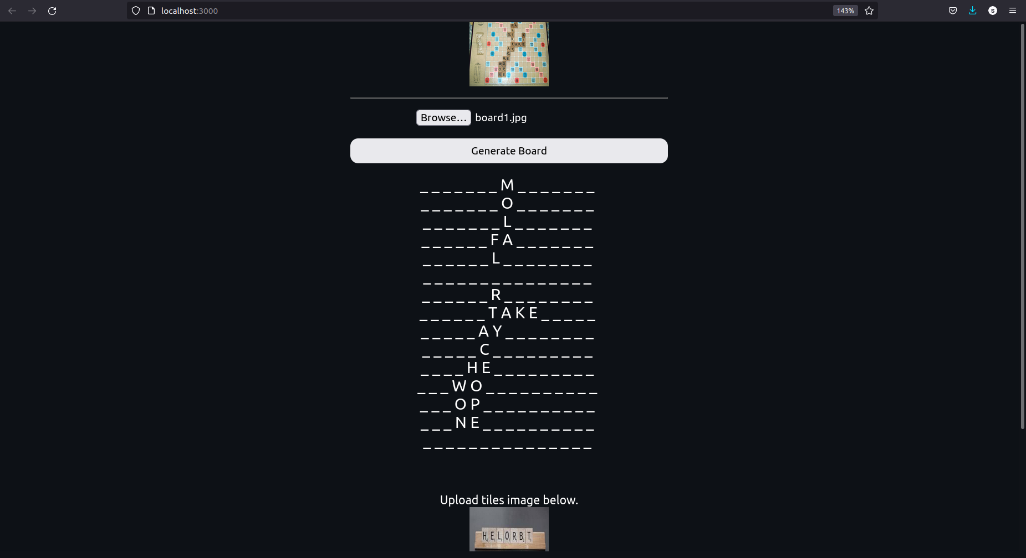
Graphical User Interface (GUI)
Simple interface where users can upload the board image and tiles image to get the board in matrix form and the best word

Slide 16
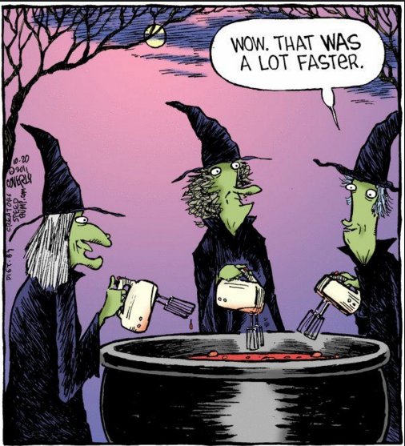
Division Of Work
SHAURYA
Input data
Grid Fitting
Graphical User Interface (GUI)
CHIRAG
Character Detection
Documentation
Powerpoint
HARSHWARDHAN
Input data
Grid Detection and Skew Correction
Character Recognition
SHIVANSHU
Preprocessing
Python Base Word Suggestion Engine
- Oracle
Word Directory Creation

Slide 17
THANK YOU

